Slide 1
CSE408
Divide and Conquer
Lecture #9&10

Slide 2
Divide-and-Conquer
The most-well known algorithm design strategy:
Divide instance of problem into two or more smaller instances
Solve smaller instances recursively
Obtain solution to original (larger) instance by combining these solutions

Slide 3
Divide-and-Conquer Technique (cont.)
a problem of size n
(instance)
subproblem 1
of size n/2
subproblem 2
of size n/2
a solution to
subproblem 1
a solution to
subproblem 2
a solution to
the original problem
It general leads to a recursive algorithm!

Slide 4
Divide-and-Conquer Examples
Sorting: mergesort and quicksort
Binary tree traversals
Binary search (?)
Multiplication of large integers
Matrix multiplication: Strassen’s algorithm
Closest-pair and convex-hull algorithms

Slide 5
General Divide-and-Conquer Recurrence
T(n) = aT(n/b) + f (n) where f(n) ∈ Θ(n^{d}), d ≥ 0
Master Theorem: If a < b^{d}, T(n) ∈ Θ(n^{d})
If a = b^{d}, T(n) ∈ Θ(n^{d} log n)
If a > b^{d}, T(n) ∈ Θ(n^{log b a} )
Note: The same results hold with O instead of Θ.
Examples: T(n) = 4T(n/2) + n ⇒ T(n) ∈ ?
T(n) = 4T(n/2) + n² ⇒ T(n) ∈ ?
T(n) = 4T(n/2) + n³ ⇒ T(n) ∈ ?
Θ(n^2)
Θ(n^2log n)
Θ(n^3)

Slide 6
Mergesort
Split array A[0..n-1] into about equal halves and make copies of each half in arrays B and C
Sort arrays B and C recursively
Merge sorted arrays B and C into array A as follows:
  Repeat the following until no elements remain in one of the arrays:
    compare the first elements in the remaining unprocessed portions of the arrays
    copy the smaller of the two into A, while incrementing the index indicating the unprocessed portion of that array
  Once all elements in one of the arrays are processed, copy the remaining unprocessed elements from the other array into A.

Slide 7
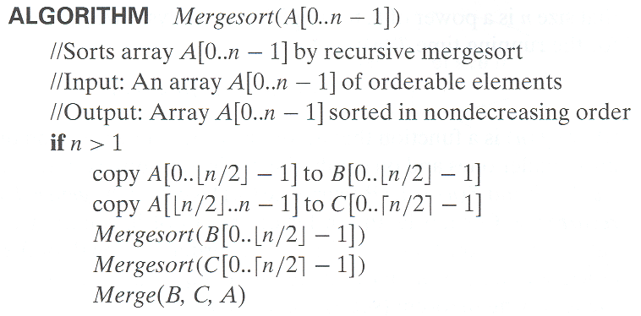
Pseudocode of Mergesort

Slide 8
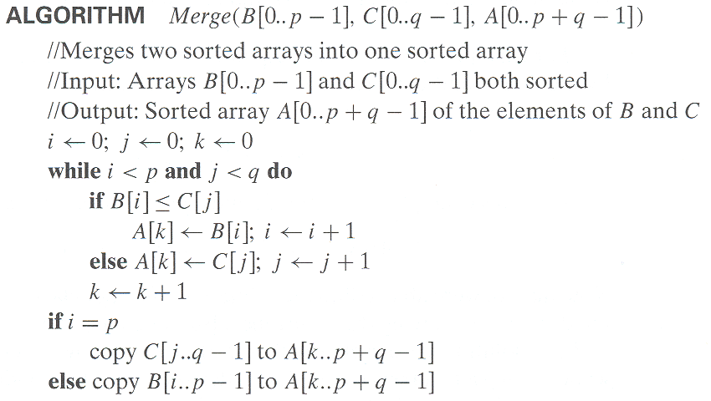
Pseudocode of Merge
Time complexity: Θ(p+q) = Θ(n) comparisons

Slide 9
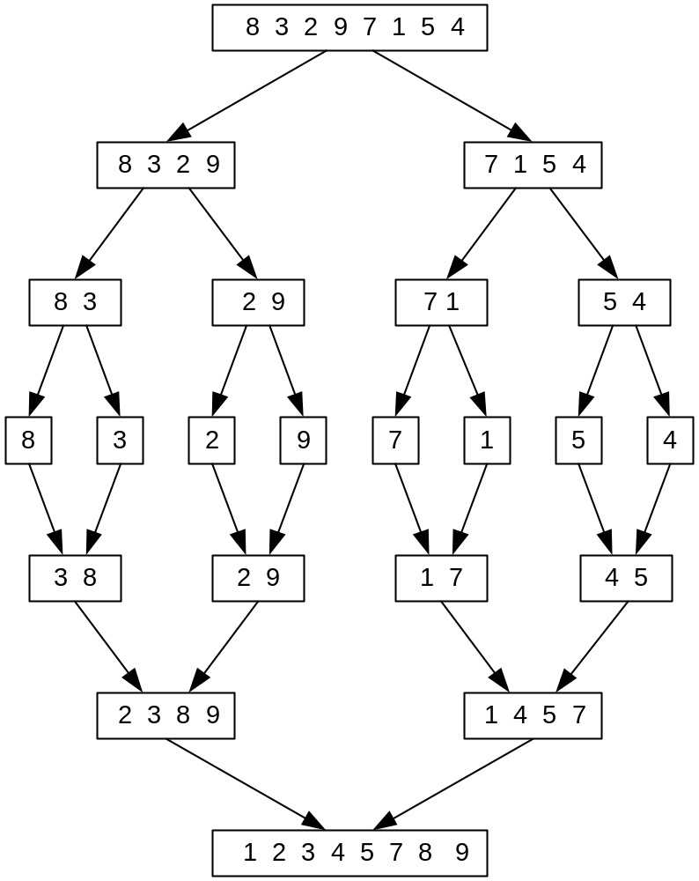
Mergesort Example
The non-recursive version of Mergesort starts from merging single elements into sorted pairs.
Notes:
Go over this example in detail, then do another example of merging, something like:
(1 2 5 7 9)
(3 4 6)

Slide 10
Analysis of Mergesort
All cases have same efficiency: Θ(n log n)
Number of comparisons in the worst case is close to theoretical minimum for comparison-based sorting:
  ⎡log₂ n!⎤ ≈ n log₂ n - 1.44n
Space requirement: Θ(n) (not in-place)
Can be implemented without recursion (bottom-up)
T(n) = 2T(n/2) + Θ(n), T(1) = 0
Notes:
even if not analyzing in detail, show the recurrence for mergesort in worst case:
T(n) = 2 T(n/2) + (n-1)
worst case comparisons for merge

Slide 11
Quicksort
Select a pivot (partitioning element) – here, the first element
Rearrange the list so that all the elements in the first s positions are smaller than or equal to the pivot and all the elements in the remaining n-s positions are larger than or equal to the pivot (see next slide for an algorithm)
Exchange the pivot with the last element in the first (i.e., ≤) subarray — the pivot is now in its final position
Sort the two subarrays recursively
p
A[i]≤p
A[i]≥p

Slide 12
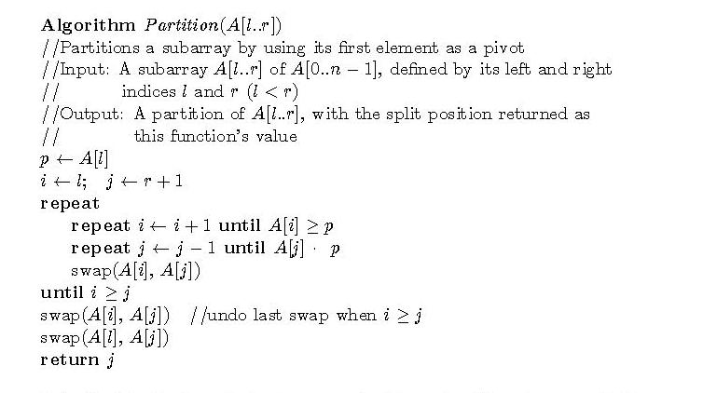
Partitioning Algorithm
or i > r
or j = l
<
Time complexity: Θ(r-l) comparisons

Slide 13
Quicksort Example
5 3 1 9 8 2 4 7
2 3 1 4 5 8 9 7
1 2 3 4 5 7 8 9
1 2 3 4 5 7 8 9
1 2 3 4 5 7 8 9
1 2 3 4 5 7 8 9

Slide 14
Analysis of Quicksort
Best case: split in the middle — Θ(n log n)
Worst case: sorted array! — Θ(n²)
Average case: random arrays — Θ(n log n)
Improvements:
  better pivot selection: median of three partitioning
  switch to insertion sort on small subfiles
  elimination of recursion
  These combine to 20-25% improvement
Considered the method of choice for internal sorting of large files (n ≥ 10000)
T(n) = T(n-1) + Θ(n)

Slide 15
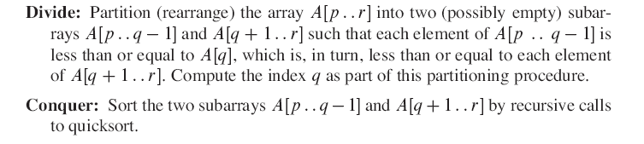

Slide 16
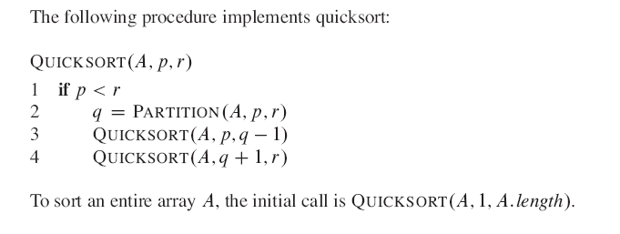

Slide 17
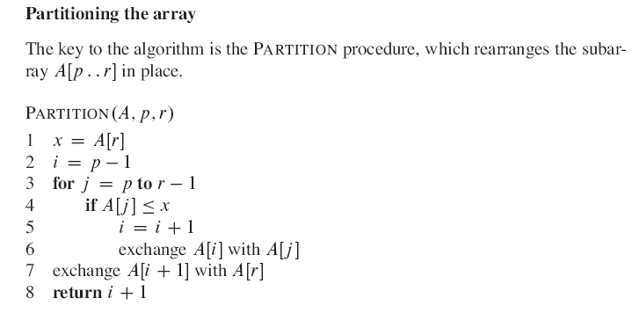

Slide 18
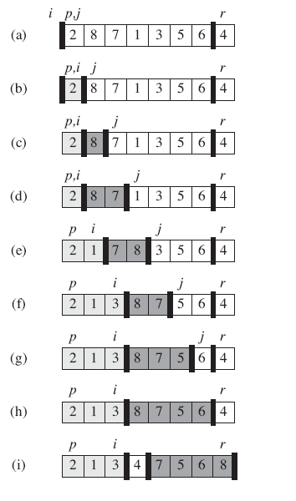

Slide 19
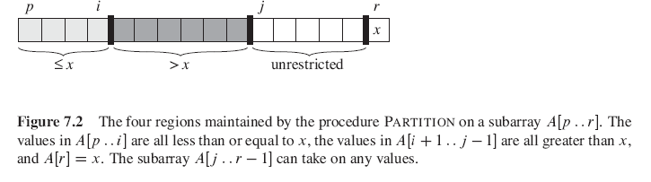

Slide 20
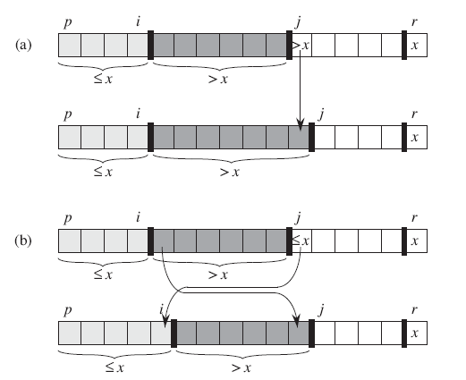

Slide 21

WORST CASE

Slide 22

Best Case

Slide 23
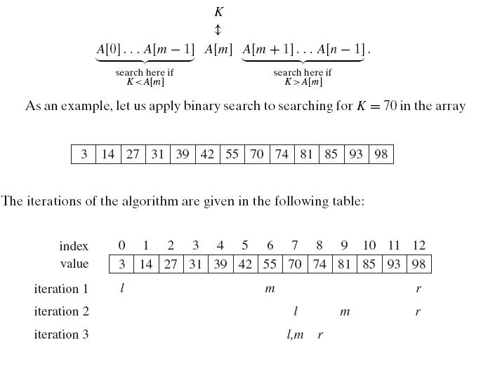

Slide 24
Binary Search
Very efficient algorithm for searching in sorted array:
K
vs
A[0] . . . A[m] . . . A[n-1]
If K = A[m], stop (successful search); otherwise, continue
searching by the same method in A[0..m-1] if K < A[m]
and in A[m+1..n-1] if K > A[m]
l ← 0; r ← n-1
while l ≤ r do
m ← ⎣(l+r)/2⎦
if K = A[m] return m
else if K < A[m] r ← m-1
else l ← m+1
return -1

Slide 25
Analysis of Binary Search
Time efficiency
  worst-case recurrence: C_{w} (n) = 1 + C_{w}( ⎣n/2⎦ ), C_{w} (1) = 1
  solution: C_{w}(n) = ⎡log₂(n+1)⎤
  This is VERY fast: e.g., C_{w}(10⁶) = 20
Optimal for searching a sorted array
Limitations: must be a sorted array (not linked list)
Bad (degenerate) example of divide-and-conquer
because only one of the sub-instances is solved
Has a continuous counterpart called bisection method for solving equations in one unknown f(x) = 0 (see Sec. 12.4)

Slide 26
Binary Tree Algorithms
Binary tree is a divide-and-conquer ready structure!
Ex. 1: Classic traversals (preorder, inorder, postorder)
Algorithm Inorder(T)
if T ≠ ∅ a a
Inorder(T_{left}) b c b c
print(root of T) d e   d e
Inorder(T_{right})    
Efficiency: Θ(n). Why?
Each node is visited/printed once.

Slide 27
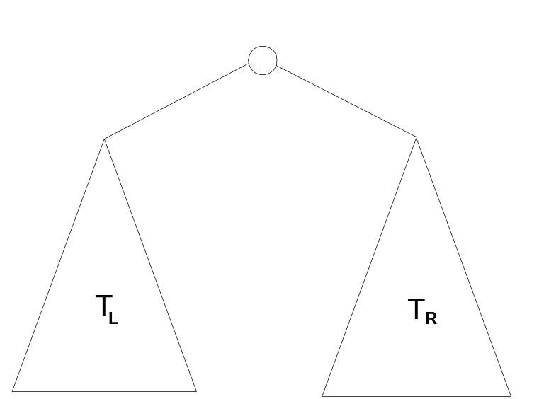
Binary Tree Algorithms (cont.)
Ex. 2: Computing the height of a binary tree
h(T) = max{h(T_{L}), h(T_{R})} + 1 if T ≠ ∅ and h(∅) = -1
Efficiency: Θ(n). Why?

Slide 28
Multiplication of Large Integers
Consider the problem of multiplying two (large) n-digit integers represented by arrays of their digits such as:
A = 12345678901357986429 B = 87654321284820912836
The grade-school algorithm:
a₁ a₂ … a_{n}
b₁ b₂ … b_{n}
(d₁₀) d₁₁d₁₂ … d_{1n}
(d₂₀) d₂₁d₂₂ … d_{2n}
… … … … … … …
(d_{n0}) d_{n1}d_{n2} … d_{nn}
Efficiency: Θ(n²) single-digit multiplications

Slide 29
First Divide-and-Conquer Algorithm
A small example: A ∗ B where A = 2135 and B = 4014
A = (21·10² + 35), B = (40 ·10² + 14)
So, A ∗ B = (21 ·10² + 35) ∗ (40 ·10² + 14)
= 21 ∗ 40 ·10⁴ + (21 ∗ 14 + 35 ∗ 40) ·10² + 35 ∗ 14
In general, if A = A₁A₂ and B = B₁B₂ (where A and B are n-digit,
A₁, A₂, B₁, B₂ are n/2-digit numbers),
A ∗ B = A₁ ∗ B₁·10^{n} + (A₁ ∗ B₂ + A₂ ∗ B₁) ·10^{n/2} + A₂ ∗ B₂
Recurrence for the number of one-digit multiplications M(n):
M(n) = 4M(n/2), M(1) = 1
Solution: M(n) = n²

Slide 30
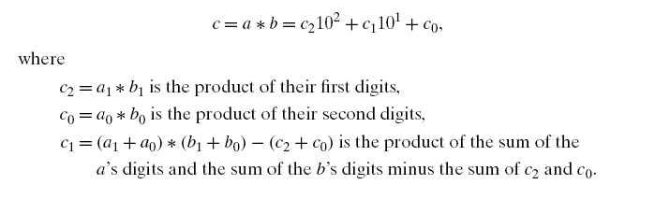
23*14

Slide 31
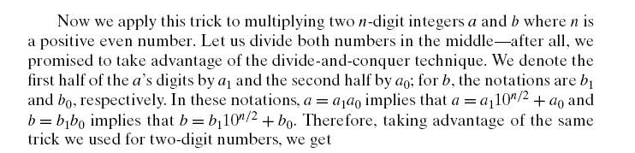

Slide 32
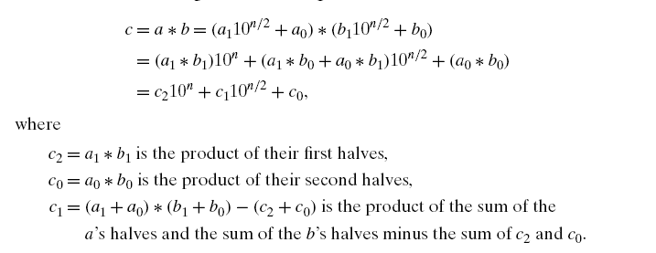

Slide 33
Second Divide-and-Conquer Algorithm
A ∗ B = A₁ ∗ B₁·10^{n} + (A₁ ∗ B₂ + A₂ ∗ B₁) ·10^{n/2} + A₂ ∗ B₂
The idea is to decrease the number of multiplications from 4 to 3:
(A₁ + A₂ ) ∗ (B₁ + B₂ ) = A₁ ∗ B₁ + (A₁ ∗ B₂ + A₂ ∗ B₁) + A₂ ∗ B_{2,}
I.e., (A₁ ∗ B₂ + A₂ ∗ B₁) = (A₁ + A₂ ) ∗ (B₁ + B₂ ) - A₁ ∗ B₁ - A₂ ∗ B_{2,}
which requires only 3 multiplications at the expense of (4-1) extra add/sub.
Recurrence for the number of multiplications M(n):
M(n) = 3M(n/2), M(1) = 1
Solution: M(n) = 3^{log 2n} = n^{log 23} ≈ n^{1.585}
What if we count both multiplications and additions?

Slide 34
Example of Large-Integer Multiplication
2135 ∗ 4014
= (21*10^2 + 35) * (40*10^2 + 14)
= (21*40)*10^4 + c1*10^2 + 35*14
where c1 = (21+35)*(40+14) - 21*40 - 35*14, and
21*40 = (2*10 + 1) * (4*10 + 0)
= (2*4)*10^2 + c2*10 + 1*0
where c2 = (2+1)*(4+0) - 2*4 - 1*0, etc.
This process requires 9 digit multiplications as opposed to 16.

Slide 35
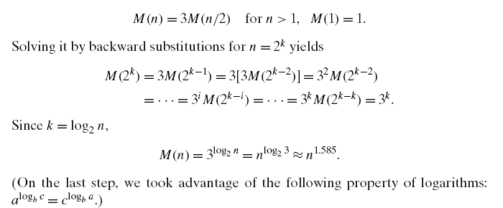

Slide 36
Conventional Matrix Multiplication
Brute-force algorithm
    c₀₀ c₀₁ a₀₀ a₀₁ b₀₀ b₀₁
    = *
    c₁₀ c₁₁ a₁₀ a₁₁ b₁₀ b₁₁
    a₀₀ * b₀₀ + a₀₁ * b₁₀ a₀₀ * b₀₁ + a₀₁ * b₁₁
    =
    a₁₀ * b₀₀ + a₁₁ * b₁₀ a₁₀ * b₀₁ + a₁₁ * b₁₁
8 multiplications
Efficiency class in general: Θ (n³)
4 additions

Slide 37
Strassen’s Matrix Multiplication
Strassen’s algorithm for two 2x2 matrices (1969):
    c₀₀ c₀₁ a₀₀ a₀₁ b₀₀ b₀₁
    = *
    c₁₀ c₁₁ a₁₀ a₁₁ b₁₀ b₁₁
    m₁ + m₄ - m₅ + m₇ m₃ + m₅
    =
    m₂ + m₄ m₁ + m₃ - m₂ + m₆
m₁ = (a₀₀ + a₁₁) * (b₀₀ + b₁₁)
m₂ = (a₁₀ + a₁₁) * b₀₀
m₃ = a₀₀ * (b₀₁ - b₁₁)
m₄ = a₁₁ * (b₁₀ - b₀₀)
m₅ = (a₀₀ + a₀₁) * b₁₁
m₆ = (a₁₀ - a₀₀) * (b₀₀ + b₀₁)
m₇ = (a₀₁ - a₁₁) * (b₁₀ + b₁₁)
7 multiplications
18 additions

Slide 38
Strassen’s Matrix Multiplication
Strassen observed [1969] that the product of two matrices can be computed in general as follows:
    C₀₀ C₀₁ A₀₀ A₀₁ B₀₀ B₀₁
    = *
    C₁₀ C₁₁ A₁₀ A₁₁ B₁₀ B₁₁
    M₁ + M₄ - M₅ + M₇ M₃ + M₅
    =
    M₂ + M₄ M₁ + M₃ - M₂ + M₆

Slide 39
Formulas for Strassen’s Algorithm
M₁ = (A₀₀ + A₁₁) ∗ (B₀₀ + B₁₁)
M₂ = (A₁₀ + A₁₁) ∗ B₀₀
M₃ = A₀₀ ∗ (B₀₁ - B₁₁)
M₄ = A₁₁ ∗ (B₁₀ - B₀₀)
M₅ = (A₀₀ + A₀₁) ∗ B₁₁
M₆ = (A₁₀ - A₀₀) ∗ (B₀₀ + B₀₁)
M₇ = (A₀₁ - A₁₁) ∗ (B₁₀ + B₁₁)

Slide 40
Analysis of Strassen’s Algorithm
If n is not a power of 2, matrices can be padded with zeros.
Number of multiplications:
M(n) = 7M(n/2), M(1) = 1
Solution: M(n) = 7^{log 2n} = n^{log 27} ≈ n^{2.807} vs. n³ of brute-force alg.
Algorithms with better asymptotic efficiency are known but they
are even more complex and not used in practice.
What if we count both multiplications and additions?

